Slide 1
Introduction to Arduinos
By Crystal Hess

Slide 2
Learning Goals
What is an embedded system?
What is an Arduino?
How to make an LED blink on an Arduino
Vocab: Arduino board, bread board, male-male wires, LEDs, compiling a program, uploading a program

Slide 3
What is an Embedded System?
An embedded system is a computer system with a dedicated function within a larger mechanical or electrical system, often with real-time computing constraints.
It is embedded as part of a complete device often including hardware and mechanical parts.
Embedded systems control many devices in common use today.

Slide 4
What is an Arduino?
A small computer on a single chip
containing a processor, memory, and input/output
Typically "embedded" inside some device that it controls
Small and low cost

Slide 6
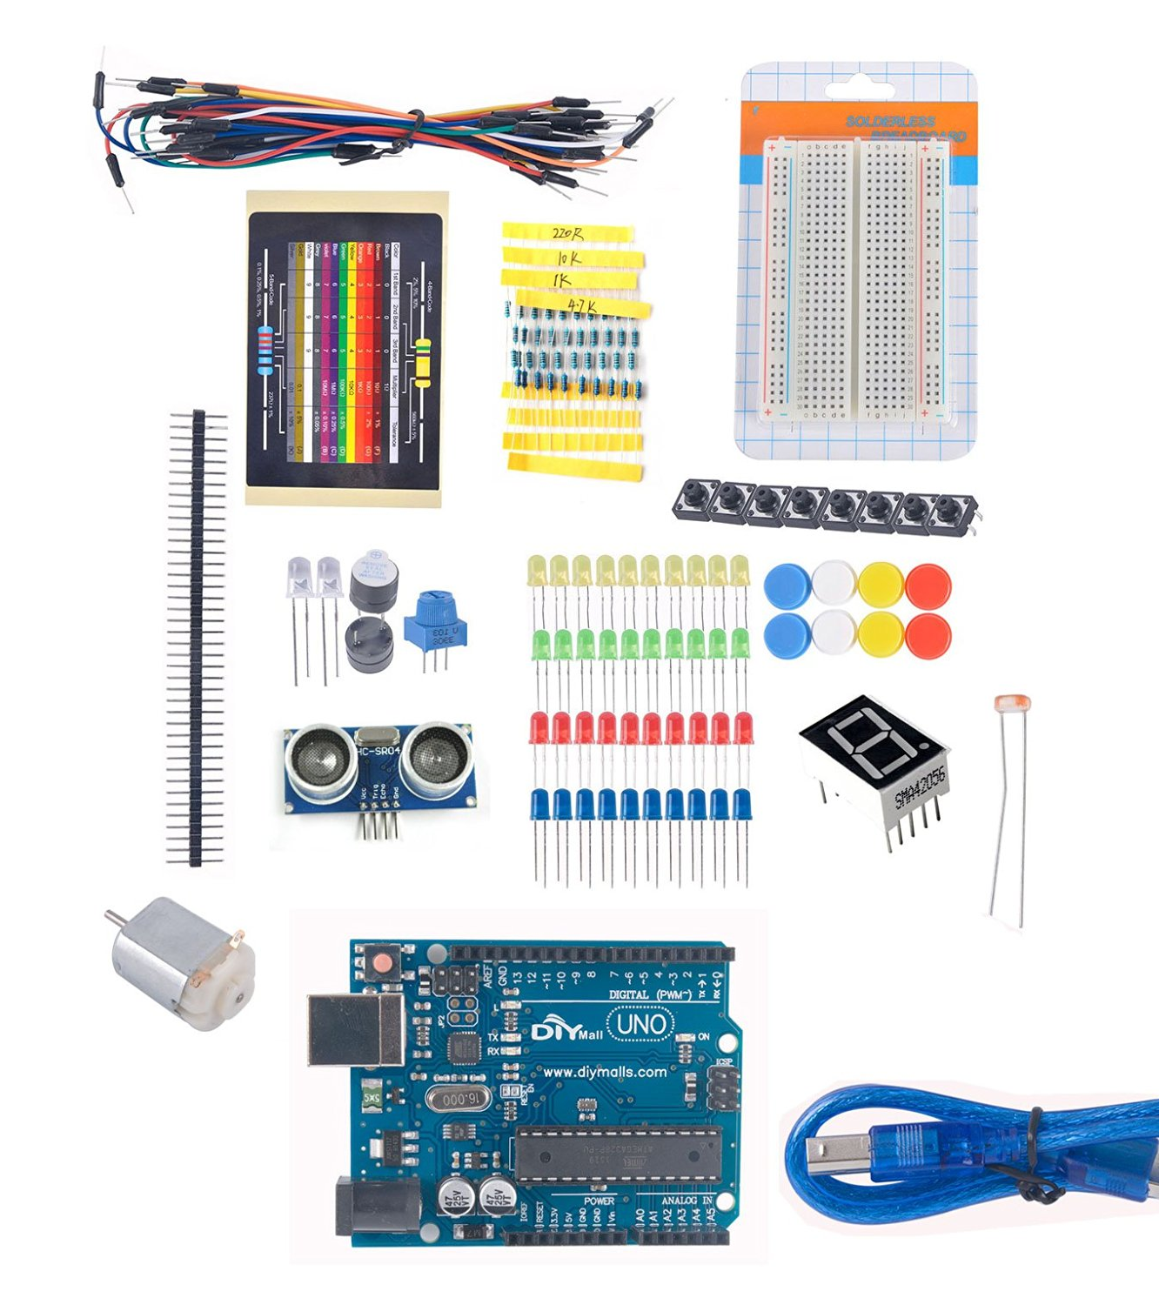
Get your own
Hardware ~ around $20
Diymall UNO R3 Beginner Learning Kit for Arduino Starter Kits LED Set Xmas Gift Experiment by DIYmall
https://amzn.com/B017SCDJ64
Software ~ free
Download at arduino.cc

Slide 7
Let’s try it!

Slide 8
Example: Blink
Hardware
Arduino board
Bread board
2 male-male wires (color doesn’t matter)
1 LED (color doesn’t matter)
Software
Launch the Arduino IDE
Select your board
Select your serial port (don’t forget this!)
Open the example Basics → Blink
Upload the program

Slide 9
Play with the Code
What does digitalWrite do? delay?
What happens if you put // (forward slash, forward slash) in front of a line of code?
What happens if you change pinMode(LED_BUILTIN, OUTPUT) to say pinMode(13,OUTPUT)? What about pinMode(9,OUTPUT)?
Can you make the LED blink using pin 9?
Challenges
Make your program light up multiple LEDs at the same time.
Make your program light up multiple LEDs at different times.
Make your program light up to the tune of “Jingle Bells”

